Slide 1
Preparing An Effective Scientific Poster
UMBC College of Natural and Mathematical Sciences
July 2019
Kathy Lee Sutphin
Assistant Dean for Academic Affairs &
Director of College Initiatives
© Kathy Lee Sutphin –
July 3, 2019

Slide 2

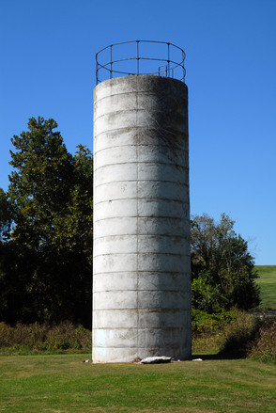
Science is about networks
… not silos
http://www.freeimages.com/photo/social-connection-1624773
and sharing accurate information is paramount!
http://www.freeimages.com/photo/silo-1204462

Slide 3
Why scientific posters?

Slide 4
“Criticism and testing are of the essence of our work. This means that science is a fundamentally social activity, which implies that it depends on good communication.”
-Hermann Bondi¹
¹Quoted by Robert A. Day in How to Write & Publish a Scientific Paper. The Oryx Press (1998) p. ix.
It is all about the importance of scientific communication!

Slide 5
Why give scientific posters?
To learn how to organize and effectively present research data
To convey findings in scientific research
To share and exchange ideas with colleagues
To serve as an alternative to longer oral presentations

Slide 6
Steps to a Poster Presentation
Conduct Research
Write & Revise Abstract
Review Abstract (by Mentor)
Submit Abstract
Prepare Presentation
Present Research

Slide 7
Steps to a Poster Presentation
Conduct Research
Write & Revise Abstract
Review Abstract (by Mentor)
Submit Abstract
Prepare Presentation
Present Research
RESEARCH

Slide 8
Steps to a Poster Presentation
Conduct Research
Write & Revise Abstract
Review Abstract (by Mentor)
Submit Abstract
Prepare Presentation
Present Research
ABSTRACT

Slide 9
ABSTRACTS
Many presentation venues require presenters to submit abstracts as part of the registration process.
TYPICAL LENGTH: 300 words or less
SUGGESTED CONTENT:
Abstracts may differ by discipline but typically includes:
    ❑ Background
    ❑ Research question/problem
    ❑ Approach and experiments
    ❑ Conclusion
Abstract Requirements & Templates
https://surf.umbc.edu/abstracts2021/

Slide 10
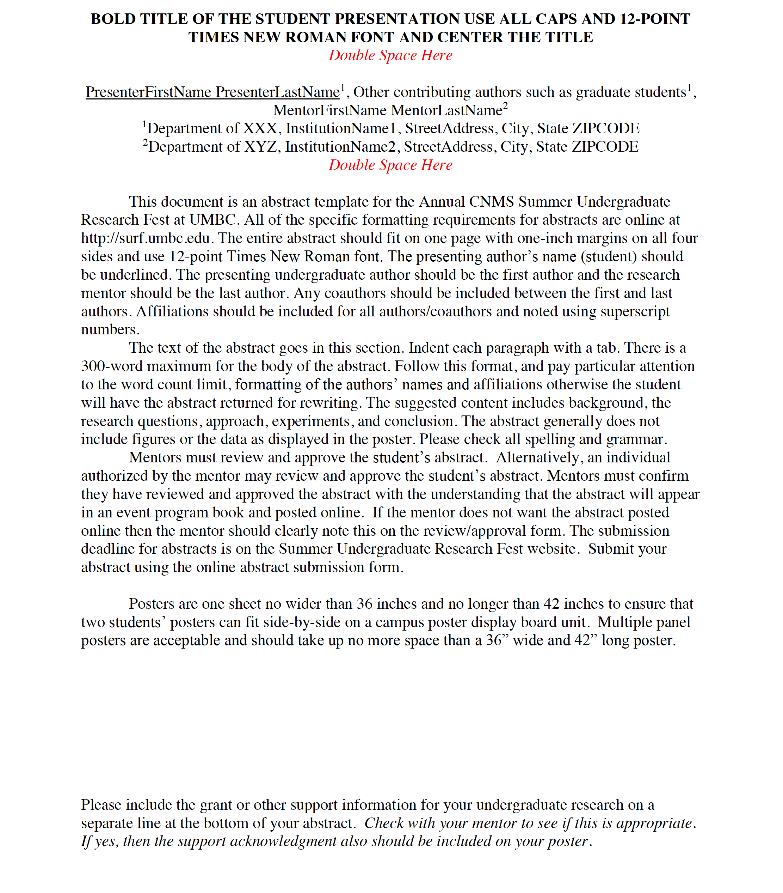
ABSTRACT TEMPLATE
Title, Authors & Affiliations
Body of the Abstract:
background, research question,
approach and experiments, and
conclusion
Acknowledgment Statement:
specifically recognize funding support of the research project. Program coordinators, directors and/or research mentors can provide this information
Abstract Requirements & Templates
https://surf.umbc.edu/abstracts2021/

Slide 11
SURF ABSTRACT FORMATTING
File Type: Abstracts must be generated in MS Word (.doc or .docx).
File Name: Please title the abstract file as follows, the presenters entire last name, followed by the first initial of their first name plus the word Abstract. Example: “SmithJAbstract.doc”
Page Format: 8.5″ x 11″ page with 1-inch margins and 12-point Times New Roman font.
Page Limit: One page for complete abstract.
Title: The abstract title should be in all CAPITAL letters.
Authors: The presenting author’s name (student) should be underlined. The presenting undergraduate author should be first author and the research mentor should be the last author. Any coauthors should be included between the first and last authors. Affiliations should be included for all authors/coauthors and noted using superscript numbers.

Slide 12
ABSTRACT FORMATTING
Affiliations: Provide the affiliation for each author. Use superscript numbers to identify which author is associated with the listed affiliations. An author may have more than one affiliation. The format for affiliations should be as follows: Department of XXX, Presenter, Institution Name, Street Address, City, State (abbreviation) ZIPCODE. Example: Department of Biological Sciences, UMBC, 1000 Hilltop Circle, Baltimore, MD 21250
Body of Abstract: Maximum word count is 300. (Title, authors, affiliations and acknowledgment statement are not included in word limit). Paragraphs must be indented using a tab.
Acknowledgment Statement: This should specifically recognize funding support of the research project with grant or other support information. Research mentors, program coordinators, and/or program directors can provide this information.
Abstract Requirements & Templates
https://surf.umbc.edu/abstracts2021/

Slide 13
ABSTRACT SUBMISSION
All abstracts must be reviewed and approved by each student’s research mentor or by an individual authorized by the mentor to review and approve the abstract.
The mentors must confirm in writing that have reviewed and approved the abstract with the understanding that the abstract will be posted online.
DEADLINE FOR ONLINE ABSTRACT SUBMISSION
Wednesday, July 26, 2021
Abstract Requirements & Templates
https://surf.umbc.edu/abstracts2021/

Slide 14

ABSTRACTS TAKE TIME….
Plan to submit your abstract to your research mentor so there is sufficient time to edit the abstract.
Talk about this now so that you know what deadline to use for your mentor’s review of your work to ensure you meet the July 26th SURF abstract submission deadline for 2021.

Slide 15
Steps to a Poster Presentation
Conduct Research
Write & Revise Abstract
Review Abstract (by Mentor)
Submit Abstract
Prepare Presentation
Present Research
CREATE THE
POSTER

Slide 16
To create an effective poster – keep the following traits in mind:
Adopt a viewer-friendly style with large (not small) typeface & informative subheadings
Provide small offerings of information vs. long paragraphs of text
Maintain a logical and orderly progression of presentation of information
Incorporate summary statement(s) of key aspects
Use easily understood language with no jargon or undefined acronyms

Slide 17
ELEMENTS OF A POSTER
Title
Author & Affiliations
Introduction
Background
Statement of the research problem
Formula(s) - use figures when possible
Data/Results and Analysis
Conclusions
References
Acknowledgments
Poster Requirements & Templates
http://surf.umbc.edu/presenters/poster-template/

Slide 18
TITLE
Title
Author & Affiliations
Introduction
Background
Statement of the research problem
Formula(s) - it is best to use figures when possible
Data/Results and Analysis
Conclusions
References
Acknowledgments
The Title of a Poster is the
First Thing a Visitor Sees
The goal is to be professional
and attract visitors to your poster.
Poster Requirements & Templates
http://surf.umbc.edu/presenters/poster-template/

Slide 19
AUTHORS
Title
Author & Affiliations
Introduction
Background
Statement of the research problem
Formula(s) - use figures when possible
Data/Results and Analysis
Conclusions
References
Acknowledgments
Authors:
Researchers who worked on the project. Primary Investigator.
Affiliations:
Follow the guidelines provided for the abstract submission.
Poster Requirements & Templates
http://surf.umbc.edu/presenters/poster-template/

Slide 20
POSTER CONTENT:
KNOW YOUR AUDIENCE
Title
Author & Affiliations
Introduction
Background
Statement of the research problem
Formula(s) - use figures when possible
Data/Results and Analysis
Conclusions
References
Acknowledgments
Focus on
making the poster
presentation
understandable
for everyone!
Poster Requirements & Templates
http://surf.umbc.edu/presenters/poster-template/

Slide 21


POSTER CONTENT:
IMAGES vs TEXT
A poster is not a research paper
Minimize Text
Maximize Illustrations and Cartoons
Title
Author & Affiliations
Introduction
Background
Statement of the research problem
Formula(s) - use figures when possible
Data/Results and Analysis
Conclusions
References
Acknowledgments
Poster Requirements & Templates
http://surf.umbc.edu/presenters/poster-template/

Slide 22
POSTER CONTENT:
WHAT IS THE TAKE HOME MESSAGE?
Title
Author & Affiliations
Introduction
Background
Statement of the research problem
Formula(s) - use figures when possible
Data/Results and Analysis
Conclusions
References
Acknowledgments
Focus on the main objectives you would like a visitor to “take away” about your research.
Poster Requirements & Templates
http://surf.umbc.edu/presenters/poster-template/

Slide 23
POSTER CONTENT:
BE CONCISE
Title
Author & Affiliations
Introduction
Background
Statement of the research problem
Formula(s) - use figures when possible
Data/Results and Analysis
Conclusions
References
Acknowledgments
Edit, Edit, Edit to get to the core messages of the poster
Avoid long blocks of text
Use small chunks of information
Poster Requirements & Templates
http://surf.umbc.edu/presenters/poster-template/

Slide 24
POSTER CONTENT:
TECHNICAL TERMS
Define technical terms used throughout the poster
Title
Author & Affiliations
Introduction
Background
Statement of the research problem
Formula(s) - use figures when possible
Data/Results and Analysis
Conclusions
References
Acknowledgments
Poster Requirements & Templates
http://surf.umbc.edu/presenters/poster-template/

Slide 25
Explain What??
jar  gon - “The specialized language of a trade, profession, or similar group2”…
<computer jargon>²
ac  ro  nym - “A word formed from the initial letters of a name3”…
<WAC for Women’s Army Corps>³
² Webster’s II New College Dictionary, Houghton Mifflin Company. (1999) pg. 592.
³ Ibid, p. 11

Slide 26
POSTER CONTENT:
SUMMARY OF YOUR RESEARCH
Title
Author & Affiliations
Introduction
Background
Statement of the research problem
Formula(s) - use figures when possible
Data/Results and Analysis
Conclusions
References
Acknowledgments
Include a summary of the poster’s most important objectives
Use bullets and/or boldface to emphasize important information
Poster Requirements & Templates
http://surf.umbc.edu/presenters/poster-template/

Slide 27
ACKNOWLEDGMENTS
Organizations and agencies that contributed to the project, especially through funding support and/or Individuals who contributed to the project should be acknowledged.
Often placed in the lower right section of a poster:
Title
Author & Affiliations
Introduction
Background
Statement of the research problem
Formula(s) - use figures when possible
Data/Results and Analysis
Conclusions
References
Acknowledgments
Sample Acknowledgment:
This research was partially funded by the Temple University MARC U STAR program, supported by NIGMS-NIH Grant 5T34-GM087293, the NIAID-NIH Grant 5R37-AI030917 and the Howard Hughes Medical Institute at UMBC.
Poster Requirements & Templates
http://surf.umbc.edu/presenters/poster-template/

Slide 28
FROM CONTENT TO LAYOUT
Title
Author & Affiliations
Introduction
Background
Statement of the research problem
Formula(s) - it is best to use figures when possible
Data/Results and Analysis
Conclusions
References
Acknowledgments
Where does the information go on the poster?
Poster Requirements & Templates
http://surf.umbc.edu/presenters/poster-template/

Slide 29
POSTER TIPS
Reed over for errrors nd ommisssions
Use the cheek sppellling feetures on youre komputer

Slide 30
WE ARE VIRTUAL &
USING VOICETHREAD
  VoiceThread technology is an interactive tool that enables sharing of text, audio, and video on a wide variety of media; including images, PDFs, and slides.
  The Division of Information Technology (DoIT) at UMBC will post a step-by-step “How to use VoiceThread” webinar on the SURF website at surf.umbc.edu
  DoIT will also host VoiceThread Office Hours for all presenters using Blackboard Collaborate on:
  July 27, 2021 at 10:00 a.m.
  https://us.bbcollab.com/guest/ec2b27446f57450098fd4241ce8b87dc
  July 30, 2021 at 1:00 p.m.
  https://us.bbcollab.com/guest/ec2b27446f57450098fd4241ce8b87dc
  All VoiceThread presentations must be uploaded by August 2, 2021
Poster Requirements & Templates
http://surf.umbc.edu/presenters/poster-template/

Slide 31
Steps to a Poster Presentation
Conduct Research
Write & Revise Abstract
Review Abstract (by Mentor)
Submit Abstract
Prepare Presentation
Present Research
PRESENT
THE POSTER

Slide 32
PRESENTING THE POSTER
Practice giving your poster
Prepare an introduction to your research to engage visitors
Explain why your research project is important to the general population
Close with your “take-home” message in a summary

Slide 33
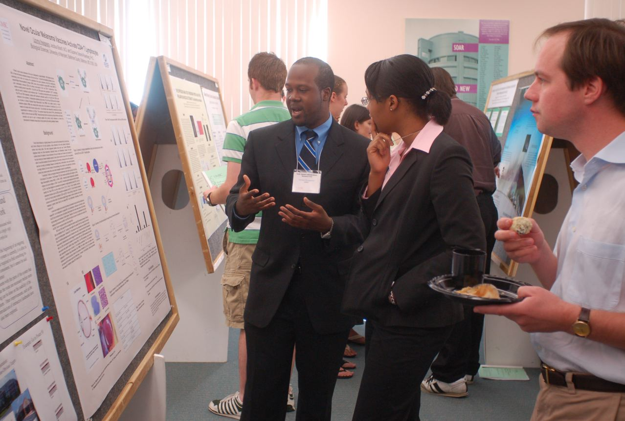
A GOOD POSTER GIVES INFORMATION
WITH OR WITHOUT THE PRESENTER

Slide 34
IMPORTANT INFORMATION
All Presenters MUST register at: https://surf.umbc.edu/registration/
Abstracts MUST be submitted by
Monday, July 26, 2021
VoiceThread Presentations MUST be submitted by
Monday, August 2, 2021
https://surf.umbc.edu/registration/

Slide 35
After SURF …
Remember to ask and receive permission in advance from your mentor for any and all future presentations of your summer research. This is critical!
Build your curriculum vitae or resume by working with your mentor to create a notation to add about your conference participation that lists the presentation authors, date, formal title of presentation, and formal name of meeting with the location.
Example:
Sutphin, K., add any other research names, & Mentor, U.R. (2018, August). Preparing an Effective Scientific Poster. Poster session presentation at the Summer Undergraduate Research Fest at UMBC, Baltimore, MD.
For more information, visit: https://gsehd.gwu.edu/content/how-conferences-are-displayed-your-resume-or-cv

Slide 36
FINISHING UP…
Seek advice from your research mentor and members of your research group/lab as your poster reflects their work
Practice giving your poster presentation to colleagues
Thank you for your attention!
Special thanks to Zoe Warwick, Ph.D. and Stephen Miller, Ph.D. for the assistance
provided to prior versions of this presentation.
© Presentation created by Kathy Lee Sutphin - updated July 3, 2019

