Slide 1
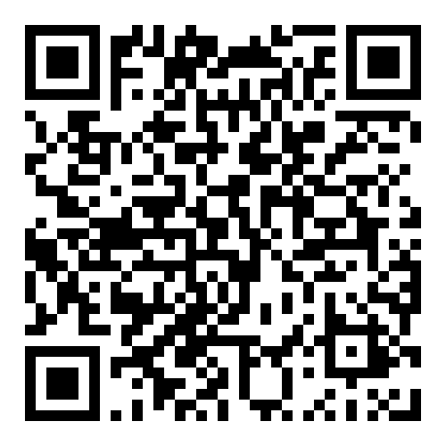
SURF: Summer Undergraduate Research Fest (Your Title should replace all this)
Poster Template Updated for 2025
University of Maryland, Baltimore County
Requirements and Deadlines:
40”wide by 30” tall max size of presentation boards.
Dark top and bottom edges are to visually hide regular black binder clips, if you plan on using pushpins, feel free to change colors.
Be mindful of the use of the UMBC logo on what type of background. Check https://styleguide.umbc.edu/graphic-elements/
for other elements and logo styles.
Grey middle bar and yellow right corner can be removed or adapted as needed.
Export as a PDF when finished to upload for printing. Have your mentor approve of the finished file before uploading to print form.
Printing deadline for Research Graphics is:
Thursday, July 31st by 5:00pm EST.
Email: researchgraphics@umbc.edu with questions.
Tips:
Double check spelling and grammar, typing text into a Word document first and checking grammar, then copy/pasting into the poster slide can help.
Have someone else read over your poster and ask them questions about content and clarity. Practice discussing your poster with peers to prepare for SURF.
Allow enough time for your mentor to review and recommend changes to your poster file.
Printing takes time, rush orders cannot be guaranteed, and many times may be turned away during busy times.
Make sure to include Acknowledgements.
For more tips and info: https://researchgraphics.umbc.edu/poster-design-resources-event-info/
When you’re ready to submit the file scan the QR code below or go to to find the link to the Google Form: https://researchgraphics.umbc.edu/welcome/poster-printing/

